Slide 1


Slide 2
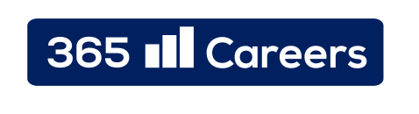
Pay attention to:
Consistency
Slide Structure
Sufficient Blank Space

Slide 3
Title
Content

Slide 4
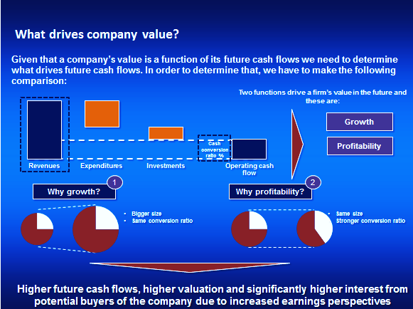
© 365careers, 2014

Slide 5
Title
Content

Slide 6
Title
Content
Content
Content
Content

Slide 7
Gridlines

Slide 8
Full Page structure
Content

Slide 9

Full Page structure
South American Market
New European Markets
The South American Market is one of the prime opportunities ahead of Kinemax
The firm has already acquired some limited experience from its Joint Venture in Brazil
The South American Market is expected to grow in double figures in the next 5 years
Kinemax plans to start operations in the Netherlands, Spain and in Norway
The firm has acquired experience from its activities in other European countries
Kinemax Growth Prospects
Penetration in existing Markets
Extension of offered Services
Cinemax will likely step up its effort to solidify its leadership position in the markets, in which the company is already present
There is significant room for growth in Turkey and in Brazil
Kinemax plans to introduce a new service in its locations: “Event rooms”
Similar service lines reinforce its image as the place to be for children in the “under 14” segment
9

Slide 10
Horizontal Half Page structure
Content
Content

Slide 11
Horizontal Half Page structure
Population: 23,702,200
GDP: 1.483 trillion $
Gini: 33.6
Currency: Australian Dollar
Australia
Population: 64,100,000
GDP: 2.435 trillion $
Gini: 32.8
Currency: Pound Sterling
United Kingdom

Slide 12
Vertical Half Page structure
Content
Content

Slide 13
Vertical Half Page structure
Revenues development
Kinemax’s revenues experienced a double digit growth throughout the period under analysis
Both cinema and other revenues grew by more than 10%, although other revenues outpaced the growth of cinema revenues (16% vs. 11%)
It seems that the company’s revenue mix is heading to a 50/50 split between Cinema and Other revenues
Gross Margin
Higher revenues transferred into a higher Gross Margin % (22.7% in FY11 vs. 25.5% in FY13)
Kinemax is able to sell its products at a good margin
Gross Margin % could be further improved by ramping up the investments in Turkey and Brazil
EBITDA
Kinemax improved its EBITDA margin as well in the period under analysis (from 7.6% in FY11 to 10.3% in FY13)
Operating expenses did not increase as fast as Gross Margin, thus EBITDA increased
Cash Conversion Ratio
The ratio between Operating Cash Flow and EBITDA varied between 76.2% and 94.3%
It was lower in FY13 due to investments in new projects

Slide 14
Quarter Page structure
Content
Content
Content
Content

Slide 15
Quarter Page structure

Slide 16
Quarter Page structure
GWP vs NWP
The overall amount of GWP reached almost 20 million in Year 3 of the period under analysis
NWP outpaced GWP due to lower amount of commissions paid to brokers
A stable growth was observed during the timeframe under consideration
Forecast
GWP volume is expected to remain stable for the next few years given current market trends
NWP’s weight as a percentage of the total mix is expected to increase
Premiums vs Commissions
Both premiums and commissions increased during the timeframe under consideration
Commissions amount to 33% of Premiums
Forecast
Current market conditions reveal that an increase in Commissions levels is expected in the future
The fastest growing Third Party channel is the Internet marketplace
Exclusive partnership with relevant Internet platforms is preferred by the large part of Insurance firms

Slide 17
One Sixth of a Page structure
Content
Content
Content
Content
Content
Content

Slide 18
One Sixth of a Page structure

